Slide 1

Modern Control Theory
Lecture No. 6
An Overview of Pole Placement
The Concept of Controllability & State Transfer
Introducing the Concept of Observability

Slide 2
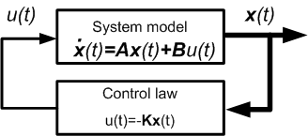
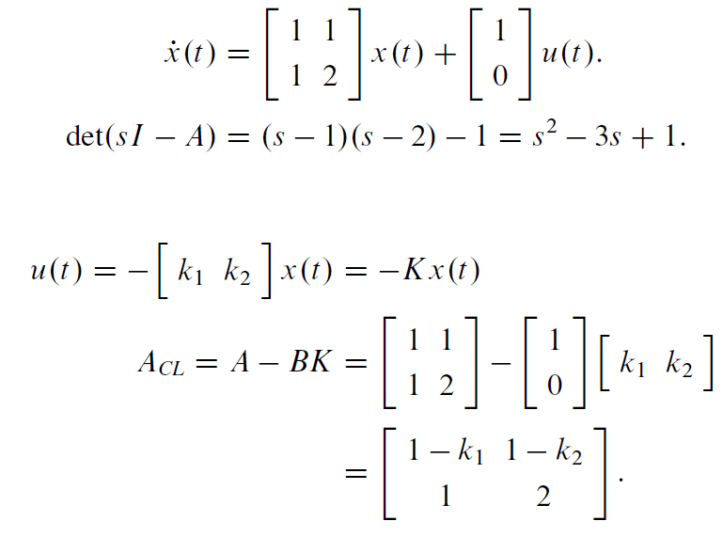

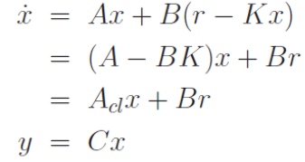
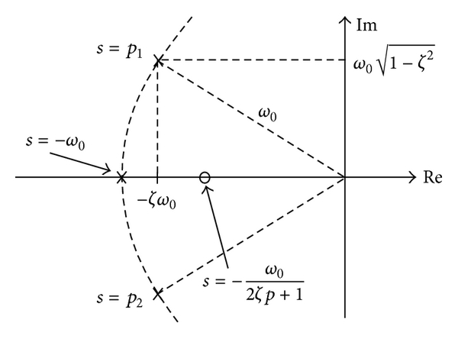


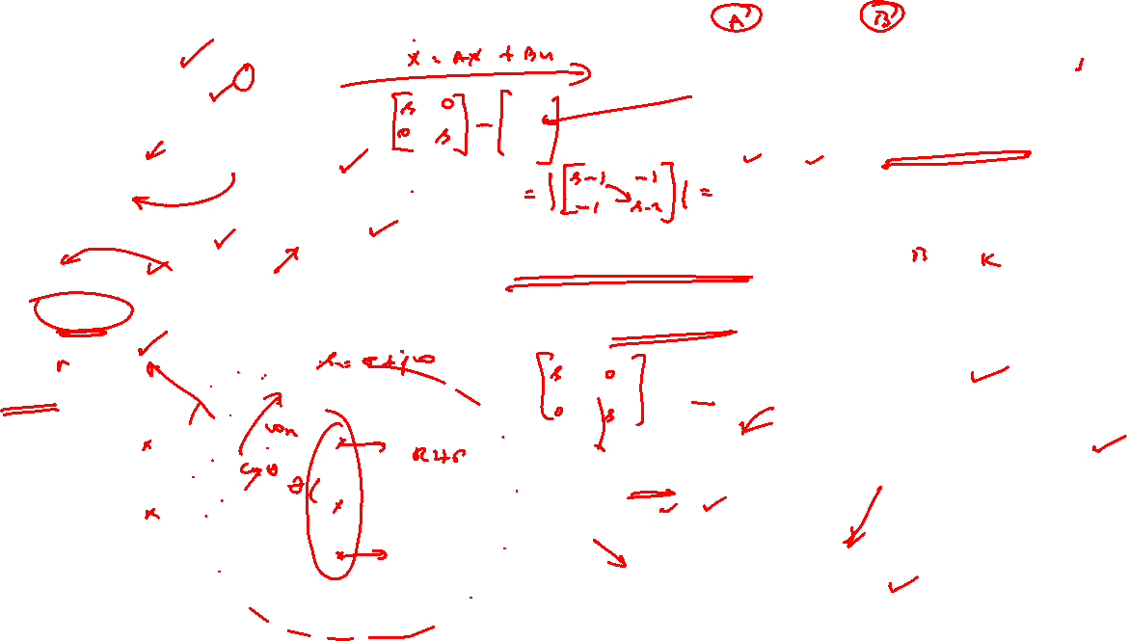

Concept of Pole Placement

Slide 3







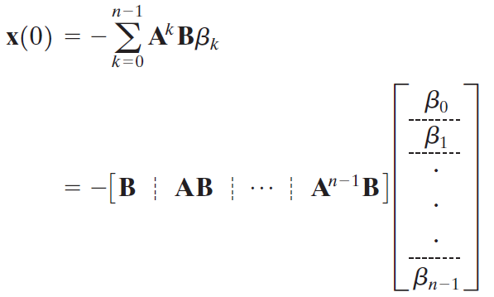

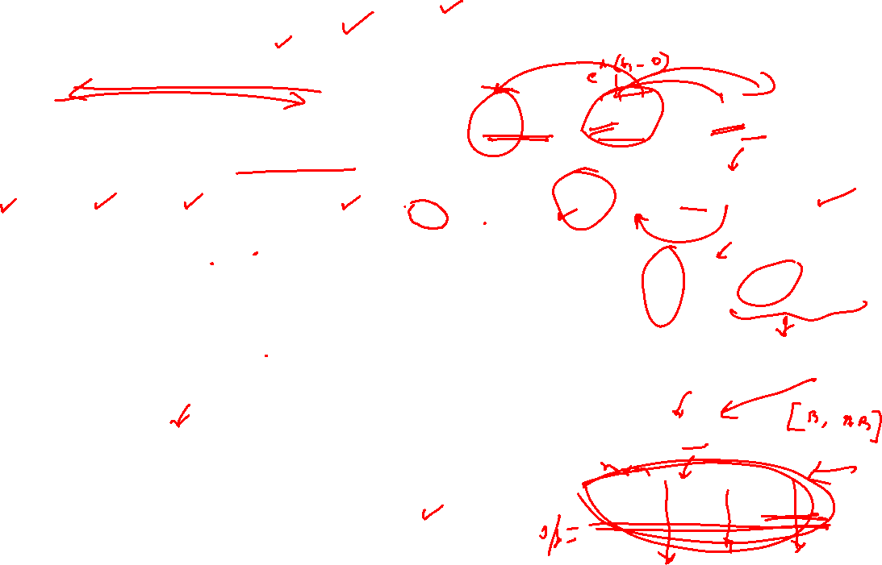
Conceptualizing Controllability from the Convolution Integral

Slide 4




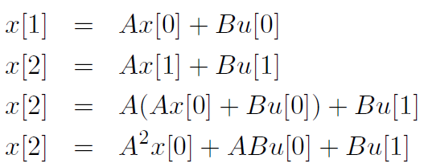





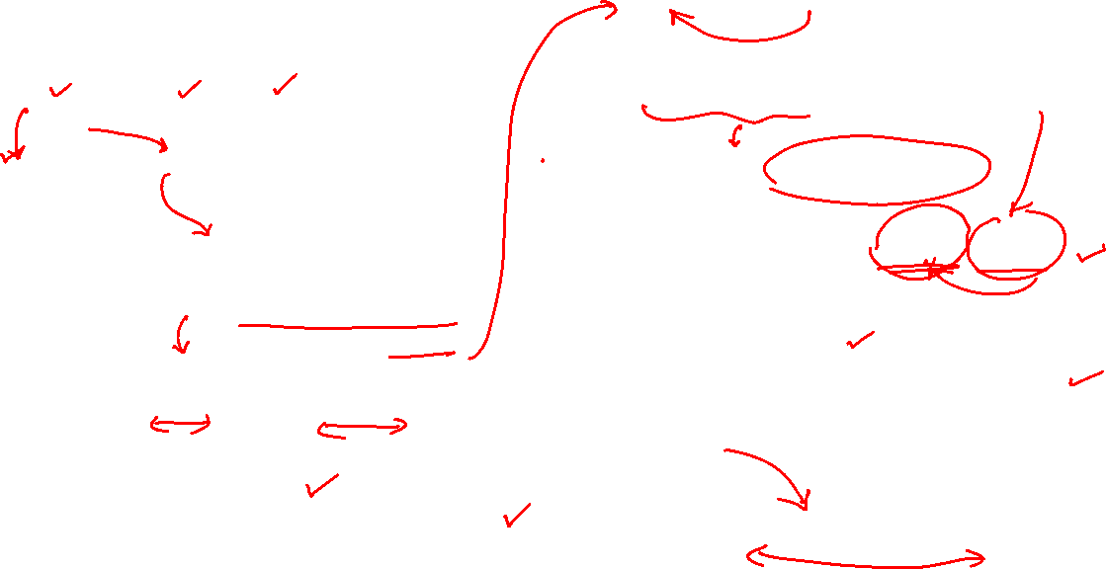
Concept of Controllability

Slide 5
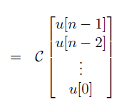
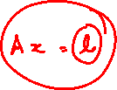

Slide 6
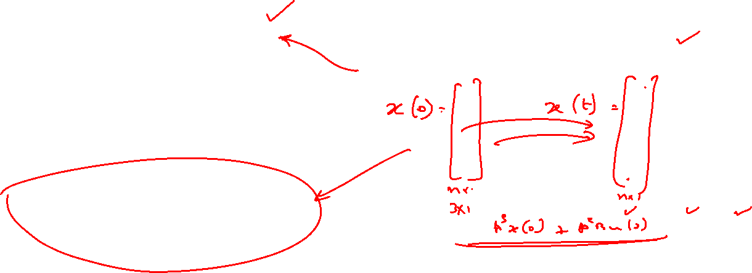
Concept of State Transfer
Beginning with an Arbitrary Known Initial State and Moving to an Arbitrary Desired Final State

